Slide 1
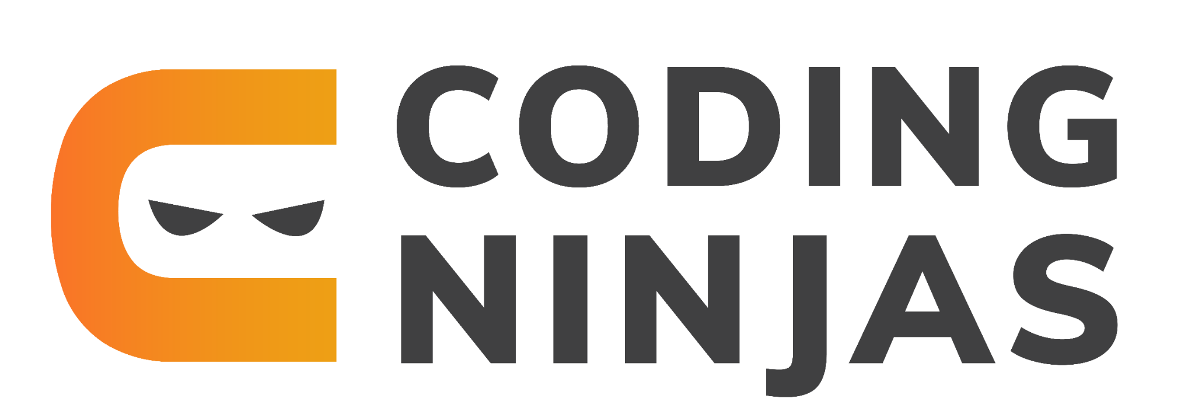

Slide 2
How to get better at developing projects

Slide 3
How to get ideas to develop projects.
Notes:
Getting ideas to build projects is the most difficult part. Hence I would always suggest to build clones of existing websites to show your side project.
SUch as clone of youtube,pinterest, twitter, swiggy, zomato. Make a clean and responsive UI

Slide 4
Apis which you can use to build projects
https://github.com/public-apis/public-apis
Notes:
You can build projects on a lot of freely available public apis.
Famous one being : https://developers.themoviedb.org/3/tv/get-popular-tv-shows

Slide 5
Language/framework you should choose and how
Notes:
Since most of you have learnt javascript or will learn javascript. Use the same in your projects.
Use react or any javascript frontend framework
And use node/express for your backend.
Dont complicate by using different languges/framework. Keep it simple

Slide 6
Libraries which can be leveraged to make your projects
Notes:
Dont reinvent the wheel.
There are a lot of libraries and projects which have created a lot of reusable components.
UI library: material ui, bulma etc
Auth: passport
Etc etc.
Just use these libraries and complete your projects. Don’t waste a lot of time in writing these libraries again.

Slide 7
Documentation for your projects.
Notes:
Good documentation will set you apart from the remaining coders.
Any good library if you choose such as redis,react,react-native you will see that all have good documentation.
Hence even in your side projects, keep that as a habit.
Document your code/ui components.
Write meaningful comments.
A good documented code will boost the confidence of your interviewer in you.
Update your readme
Use github CI plugins to check for image size etc
Add comments to your code
If possible leave a code design document
Use story books or any other ui management library

Slide 8
Hosting/final products.
Notes:
Make your you github pages/netlify/heroku to host your projects. Showcasing and hosting your project is the best way to put your project across as compared to just uploading your project to github

Slide 9
Other resources
Notes:
There are a lot of things which you can try after creating the basic crud applications such as:-
Using a pub sub model library
Using Web assembly
Reading others code
Try to contribute to open soure library (For eg. Mattermost)

Slide 10
Job related interview experience

Slide 11
The usual format of interviews (For frontend/fullstack)
Resume screening
Project/assignment
Frontend knowledge interview
DSA interview
Behavioural/Managerial Role
Notes:
Resume: keep a concise resume. Give links to all your projects/github page/blogs etc. Write about the project you have worked and under what capacity
Project/assignment is a very important part. Take time to complete it, do document your code. Add a readme. Try to write a rough design document for the code and then write it. Make sure your are resusing components and following the DRY principle.
Frontend knowledge Interview - Make sure your concepts for JS/HTML/CSS are strong. Make sure you read from the standard resources and you know all the standard questions. https://github.com/h5bp/Front-end-Developer-Interview-Questions
DSA interview - Practice is the key here. I would suggest that you try to solve 1-2 problems everyday. The more your practice, the more problem solving thinking you will develop which will help you to solve any problem given to you.
Managerial Role - usually puzzles (so go through some famous interview puzzles and discussions around you past work work. Ideally this round is to see your learning skills and how well you will collaborate with the team etc. Keep it simple.

Slide 12
Where and what to study on a high level
Resources from Coding Ninja
MDN: https://developer.mozilla.org/en-US/docs/Web/JavaScript
Just google most asked interview questions
Notes:
Dont try to study from a lot of places. Keep a list of few places and try to complete that.
Apart from CN resources (i.e after finishing CN resources)
Read topics from the MDN site for Javascript/HTML/CSS
For JS: I would say https://github.com/getify/You-Dont-Know-JS is a good resource. But make sure you make notes and read more
For good coding and code architecture i would suggest : https://egghead.io/courses/fundamentals-of-redux-course-from-dan-abramov-bd5cc867 People have github notes for this, so you can skim through that also.

